Slide 1
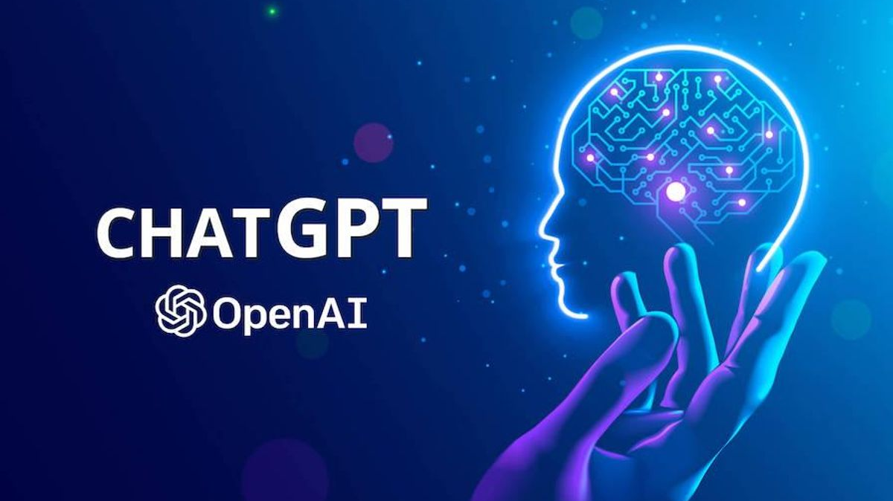

Slide 2
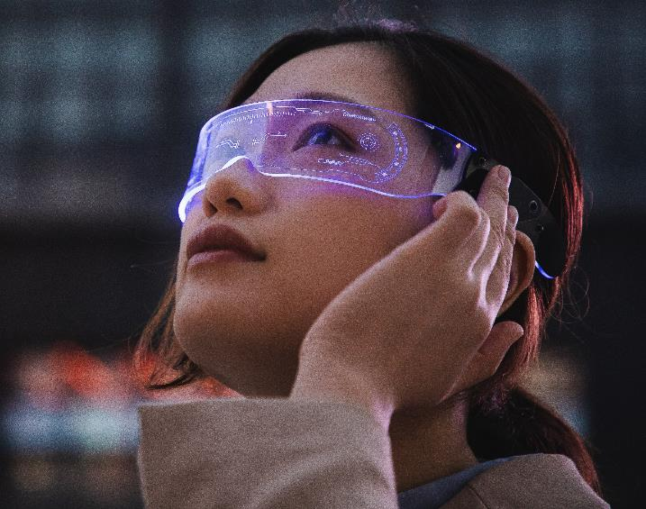
ChatGPT
Beril Dindar Cloud Solutions Consultant

Slide 3
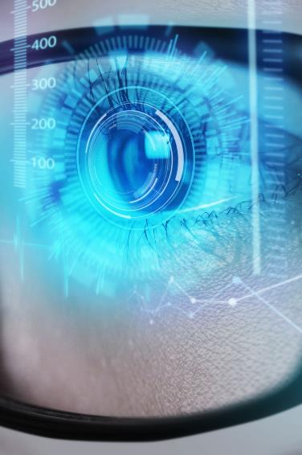
Introductıon
What is ChatGPT & AI ?
Uses of ChatGPT & NLP
Different features of ChatGPT
Uses of chatGPT
Chatbots
Automatic Answering Systems
Language Translation
Writing
Summarizing
Advantages and dısadvantages of chatgpt
Advantages
Disadvantages
The future of chatgpt
The evolution of Artificial Intelligence
The progress of ChatGPT
Future uses of ChatGPT
Conclusıon
Importance of ChatGPT
Insights on the future of ChatGPT

Slide 4
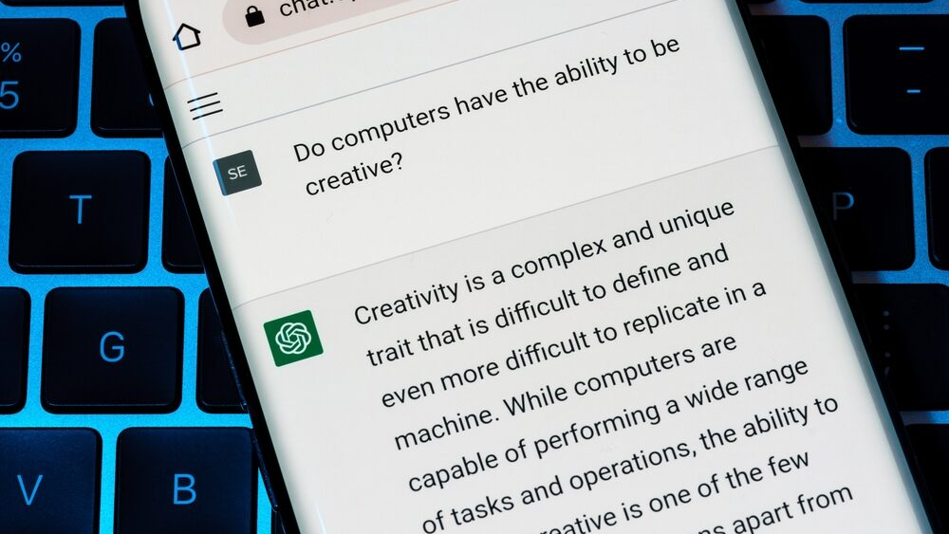
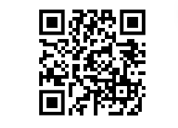
Please Scanner ME

Slide 5
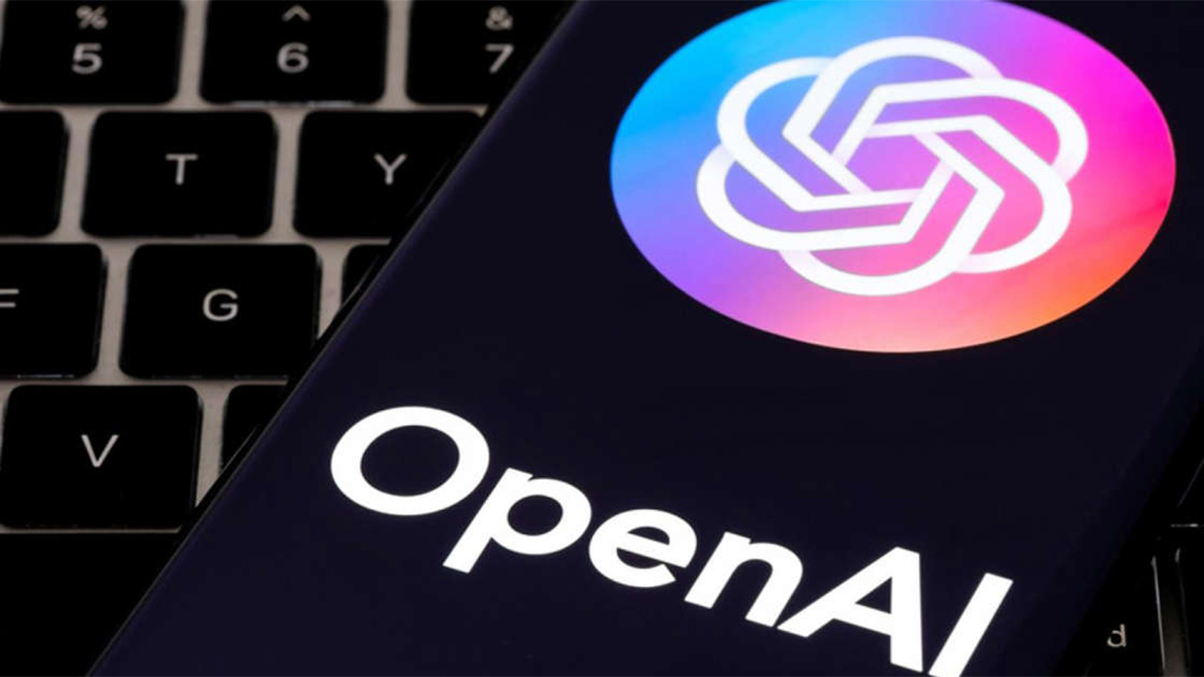
Chatgpt by openaı
ChatGPT is an artificial intelligence chatbot developed by OpenAI and launched in November 2022. It is built on top of OpenAI's GPT-3.5 and GPT-4 families of large language models and has been fine-tuned (an approach to transfer learning) using both supervised and reinforcement learning techniques.

Slide 6
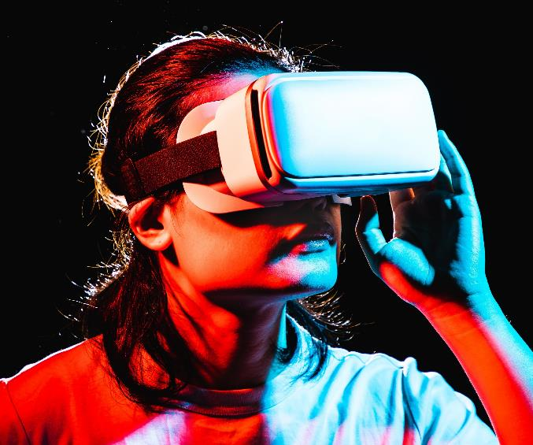
Artıfıcıal ıntellıgence
AI can be classified into two broad categories:
Narrow or Weak AI
General or Strong AI

Slide 7
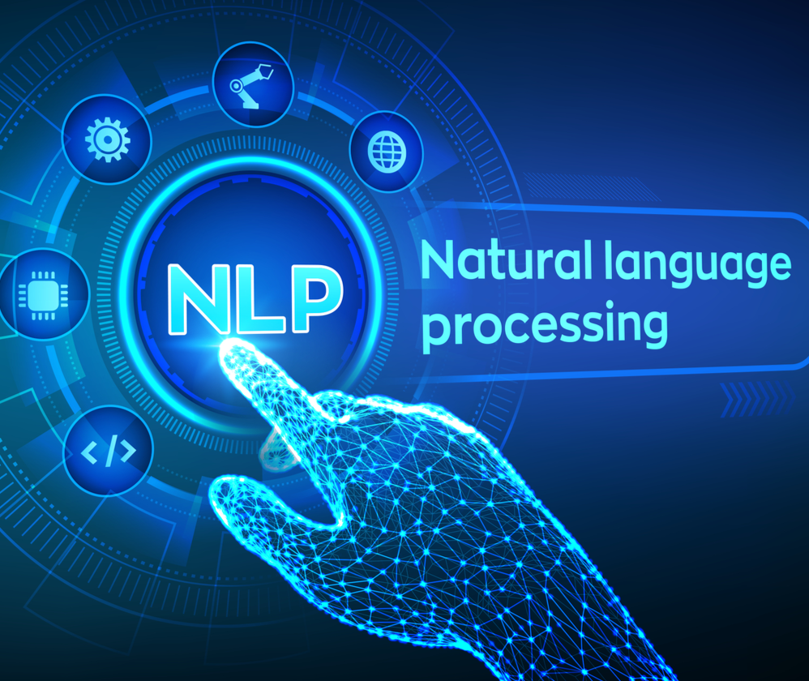
What is Natural Language Processing?
Tokenization
Part-of-speech tagging
Named Entity Recognition (NER)
Sentiment analysis
Language translation
Speech recognition

Slide 8
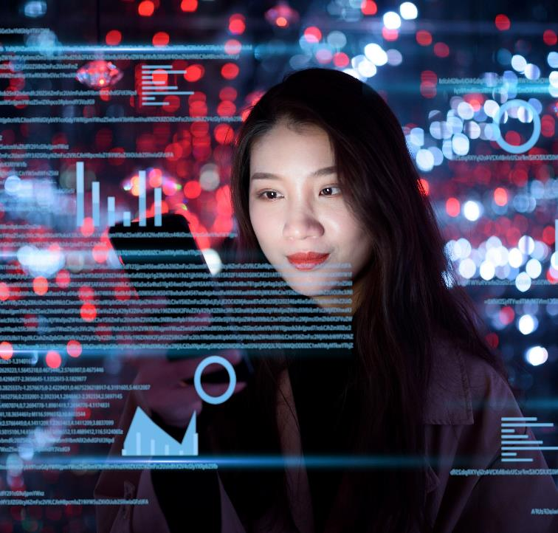
Chatgpt’s Relatıonshıp aı vs nLP
ChatGPT is an example of the power of AI and NLP in enabling machines to understand and generate natural language, opening up new possibilities for applications such as chatbots, virtual assistants, and automated customer service systems.

Slide 9
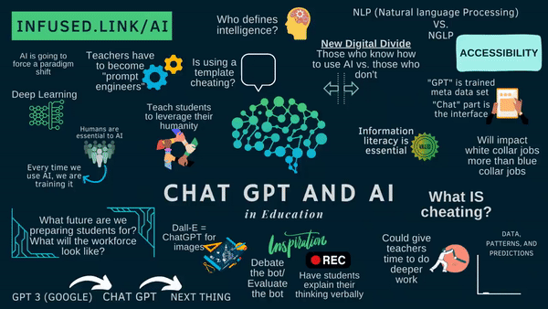

Slide 10
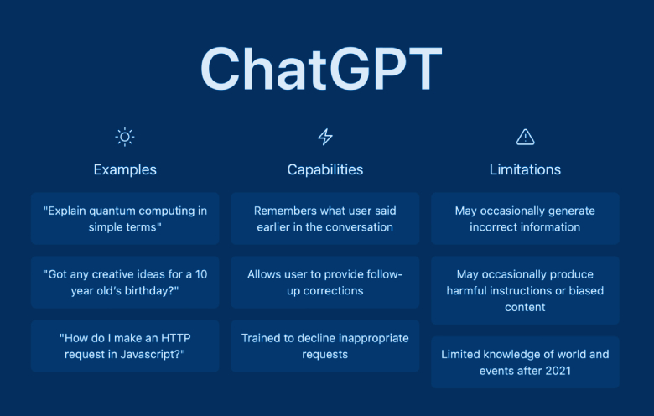

Slide 11




Chatgpt-3 vs chatgpt-4
Model sıze
effIcIency
Accuracy
Language dıversıty
This means that ChatGPT-4 will have the ability to process more information and perform more complex tasks.
ChatGPT-4 can make more accurate predictions,as it relies on a larger data set and processes more information.
ChatGPT-4 is expected to produce more accurate results than ChatGPT-3.
ChatGPT-4 is expected to offer more language diversity than ChatGPT-3.

Slide 12






DIfferent features of ChatGPT ?
Customer service
Content creation
Research
Personal assistants
Language translation
Educational tools
Healthcare

Slide 13
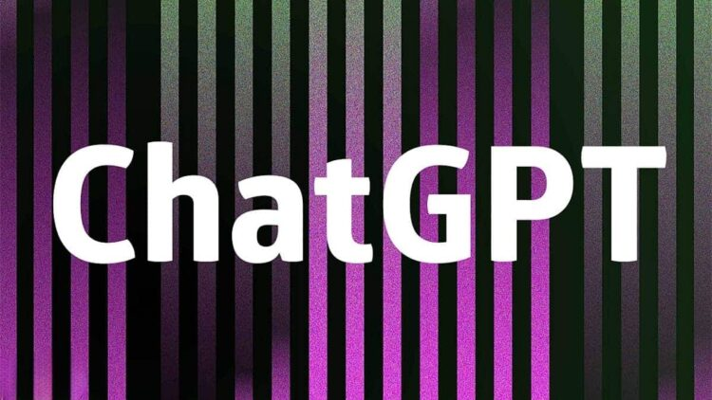
Uses of ChatGPT
Natural Language Processing (NLP)
Generative Pre-trained Transformer (GPT)
Large-scale training data
Multilingual support
Contextual awareness
Dialogue management
Emotion recognition

Slide 14
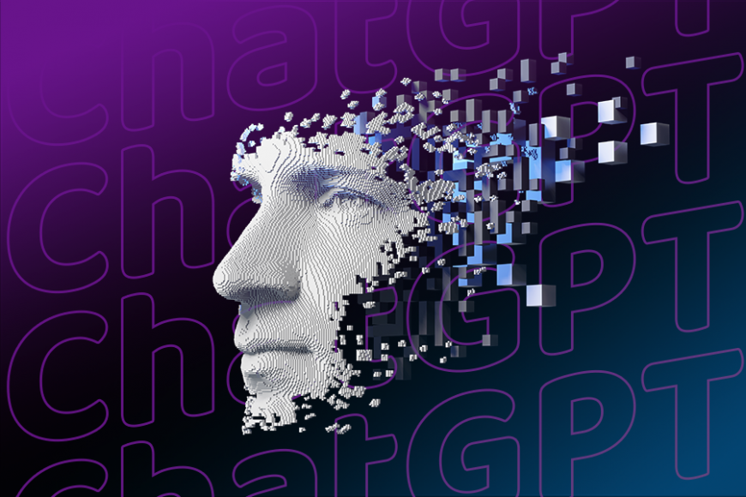
USES OF CHATGPT
Chatbots
Chatbots are computer programs that use natural language processing to interact with users through text or speech. They can be used for a variety of tasks, such as customer support, information retrieval, or entertainment.
AutomatIc AnswerIng Systems
Automatic answering systems, also known as Interactive Voice Response (IVR) systems, are computer programs that use voice recognition and text-to-speech technology to interact with users over the phone.
Language TranslatIon
Language translation refers to the process of converting text or speech from one language to another.
WrItIng
Writing software can help users generate text automatically, often using natural language processing techniques to produce human-like language.
SummarIZING
Summarizing software can automatically generate summaries of large amounts of text, which can be useful for tasks such as news aggregation or academic research.

Slide 15





CHATGPT ADVANTAGES
VersatIlIty
NLP
LearnIng capabIlIty
EffIcIency
ChatGPT can understand and generate text in a wide range of languages and topics, making it a versatile tool for communication and research.
ChatGPT uses natural language processing to understand and generate human-like responses, making interactions with it feel more natural and intuitive.
ChatGPT is constantly learning and improving its ability to understand and generate text.
ChatGPT can process and analyze large amounts of text quickly and efficiently, making it a useful tool for tasks such as language translation, content generation, and sentiment analysis.

Slide 16



CHATGPT DISADVANTAGES
Lack of true consciousness and emotional intelligence
LImIted traInIng data
BIased responses
ChatGPT is a machine learning model and lacks true consciousness and emotional intelligence. It can mimic human responses to a certain extent, but it cannot truly understand human emotions and experiences.
ChatGPT is only as good as the data it was trained on. While GPT-3 has been trained on a vast amount of data, there may be gaps in its knowledge and understanding.
ChatGPT may provide biased responses based on the data it was trained on.

Slide 17
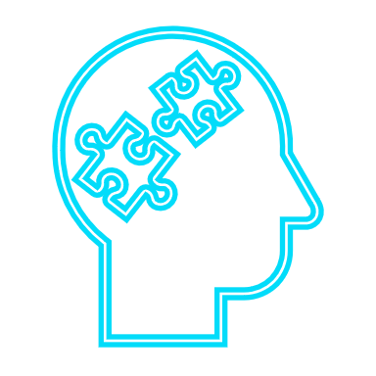


CHATGPT DISADVANTAGES
LImIted abIlIty to reason
Lack of context
SecurIty and prIvacy concerns
While ChatGPT can generate responses based on the input it receives, it may not be able to reason or understand complex concepts in the same way a human can.
ChatGPT may have difficulty understanding context and may provide inappropriate or irrelevant responses in certain situations.
Since ChatGPT is an artificial intelligence language model, it may be vulnerable to hacking or malicious use, which could potentially compromise the privacy and security of user information.

Slide 18
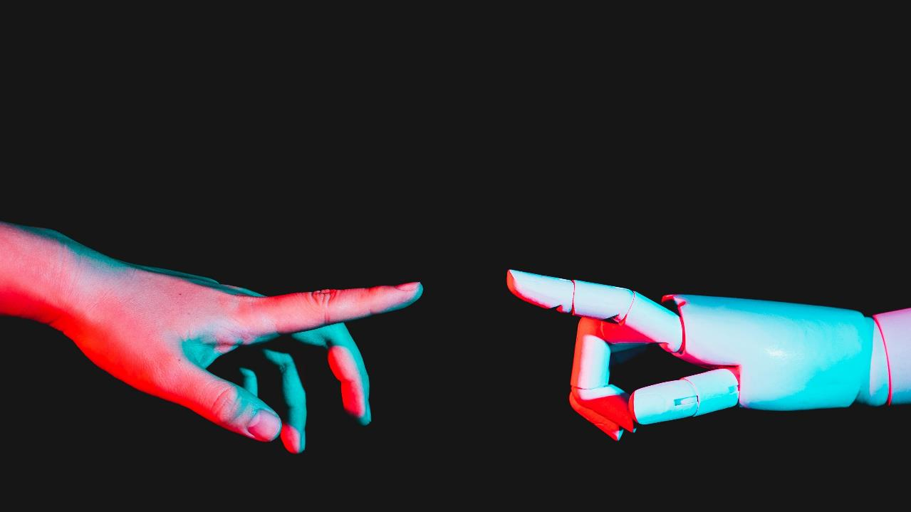
USES OF CHATGPT

Slide 19
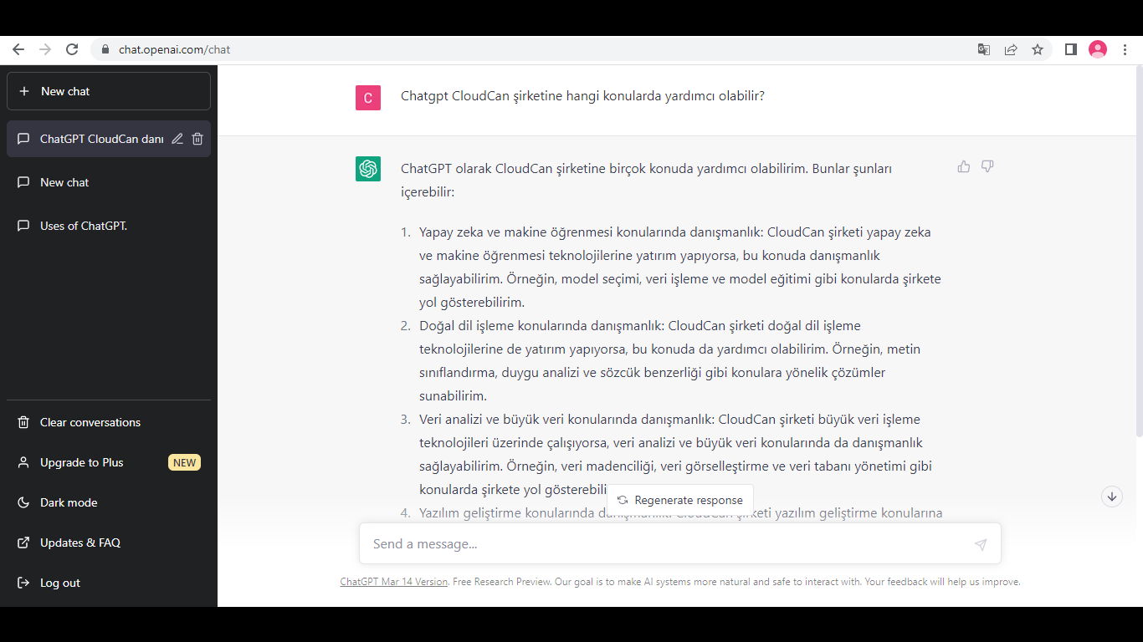

Slide 20
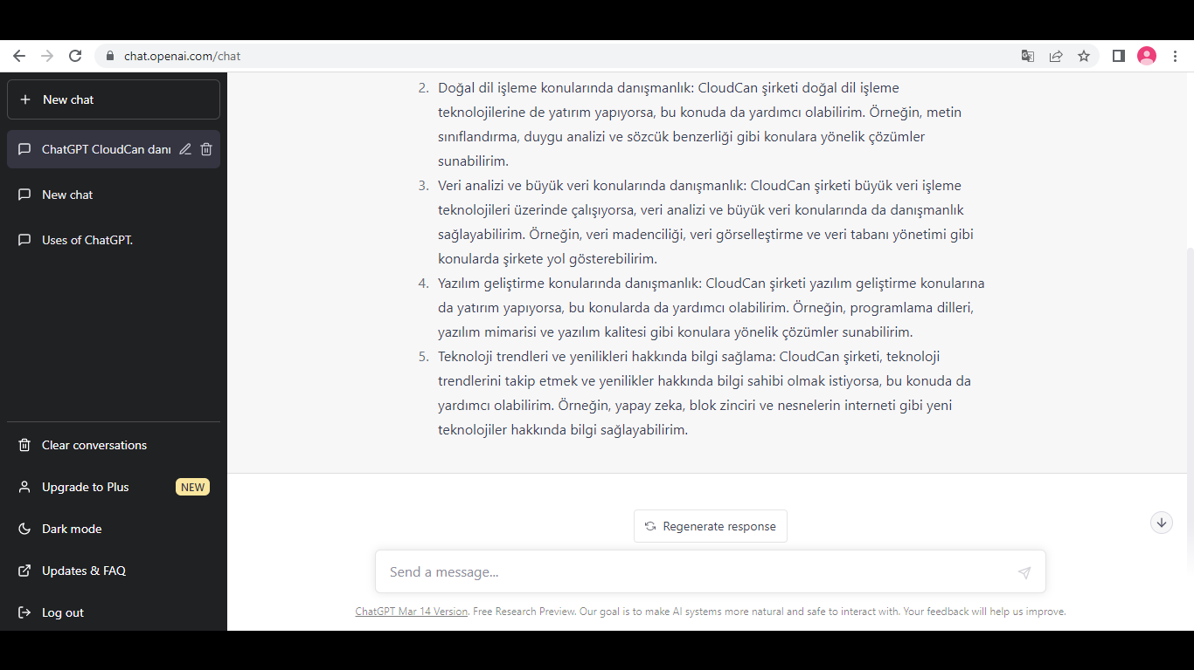

Slide 21
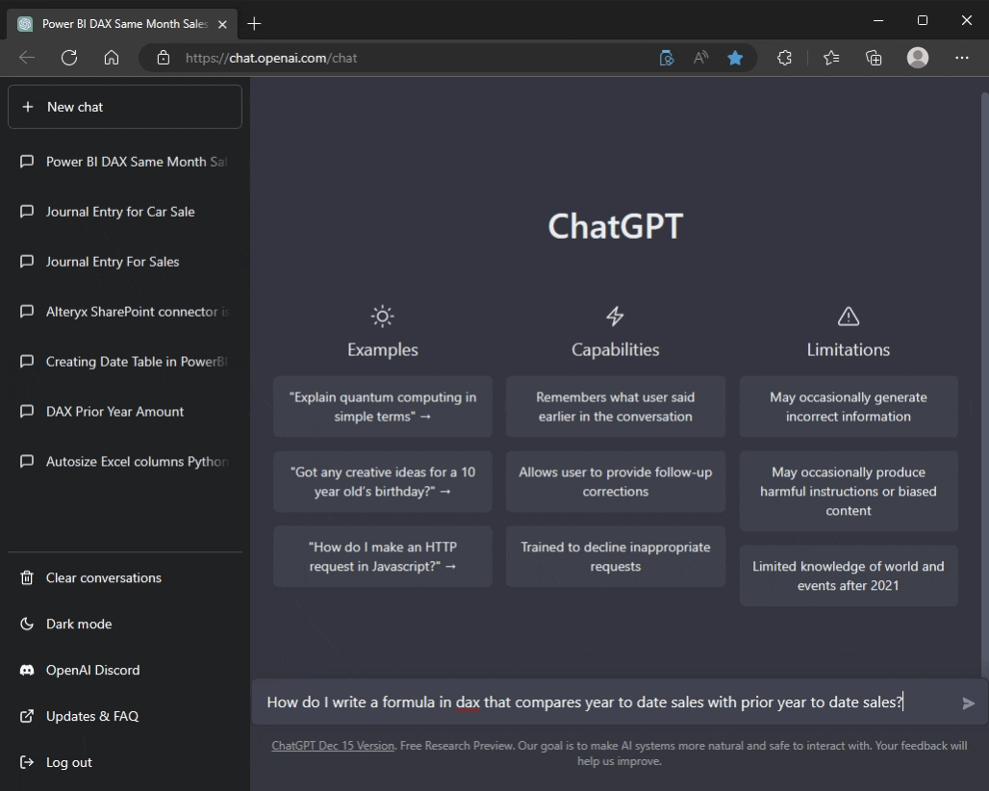

Slide 22
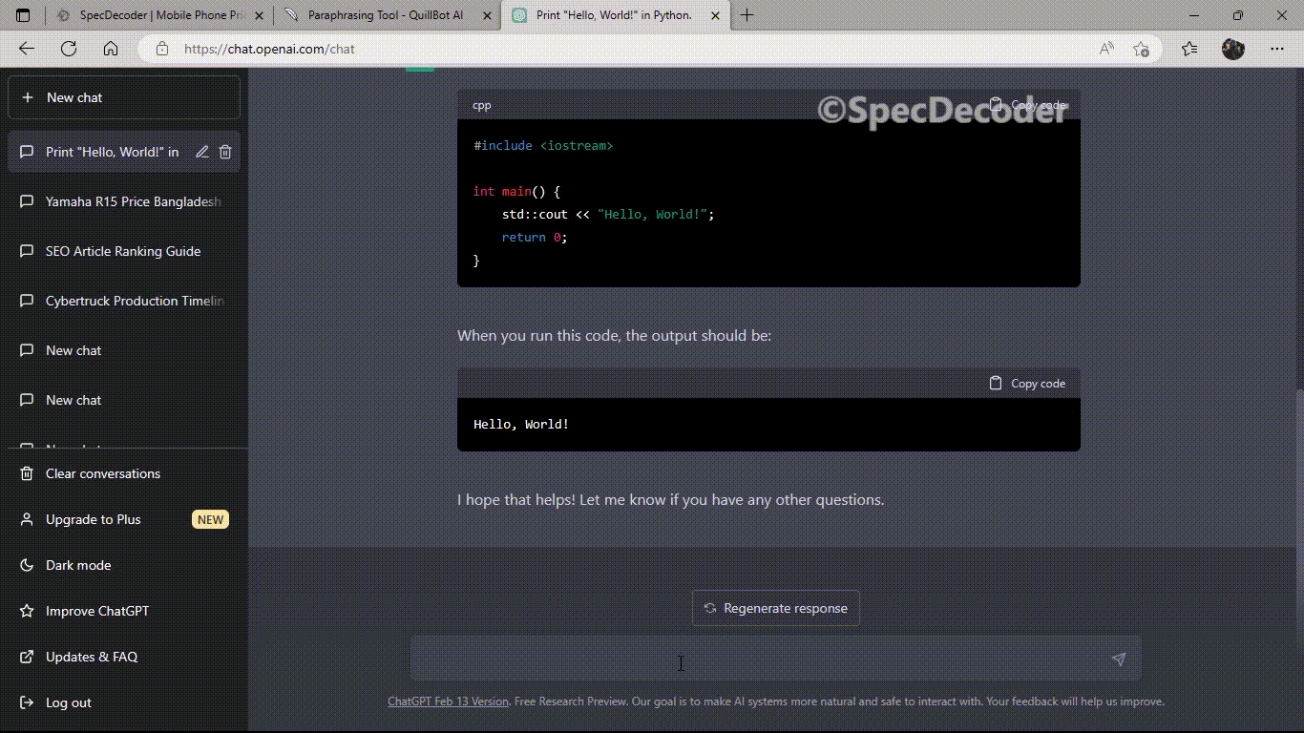

Slide 23
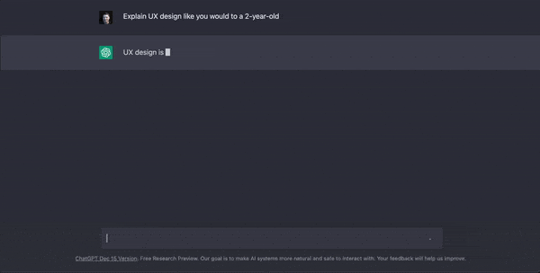

Slide 24
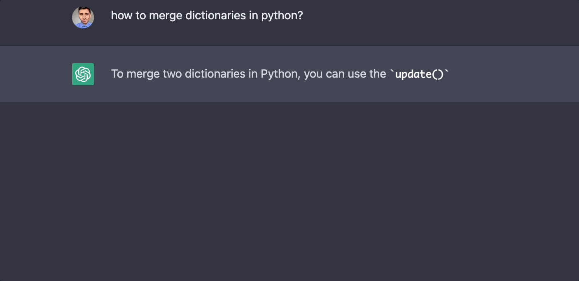

Slide 25
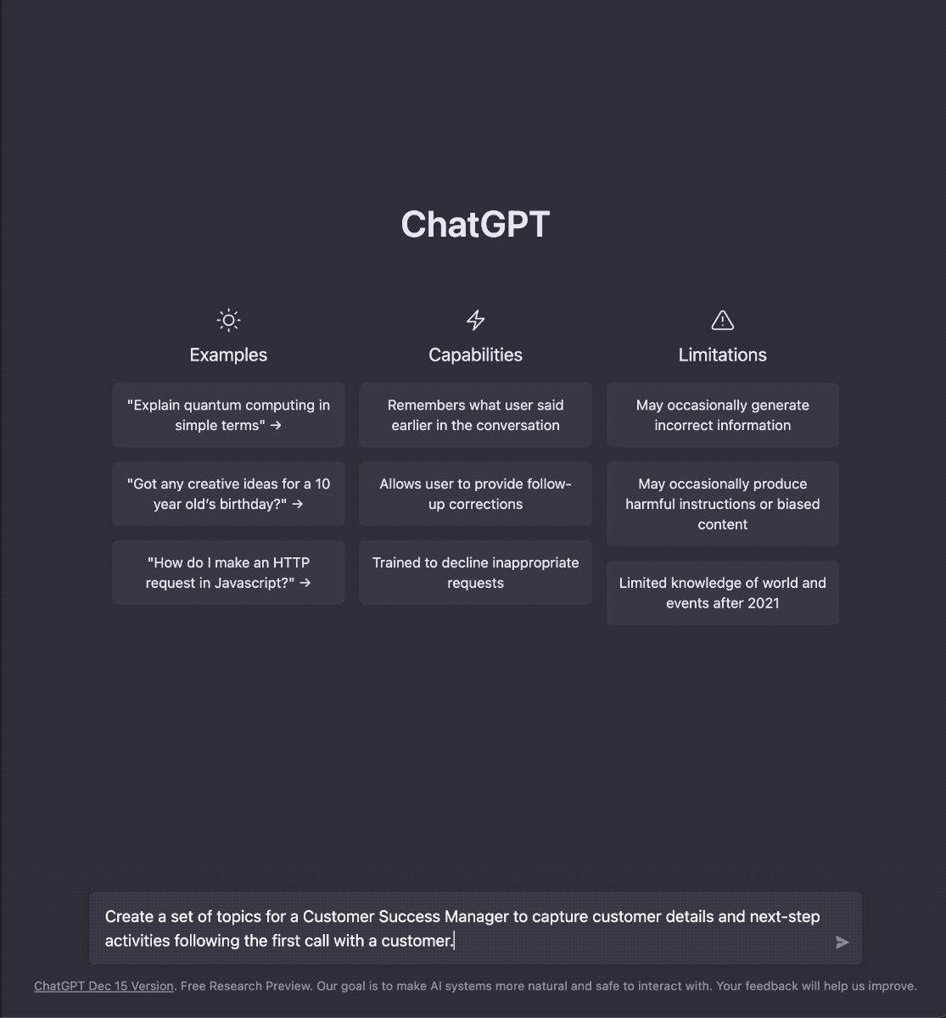

Slide 26
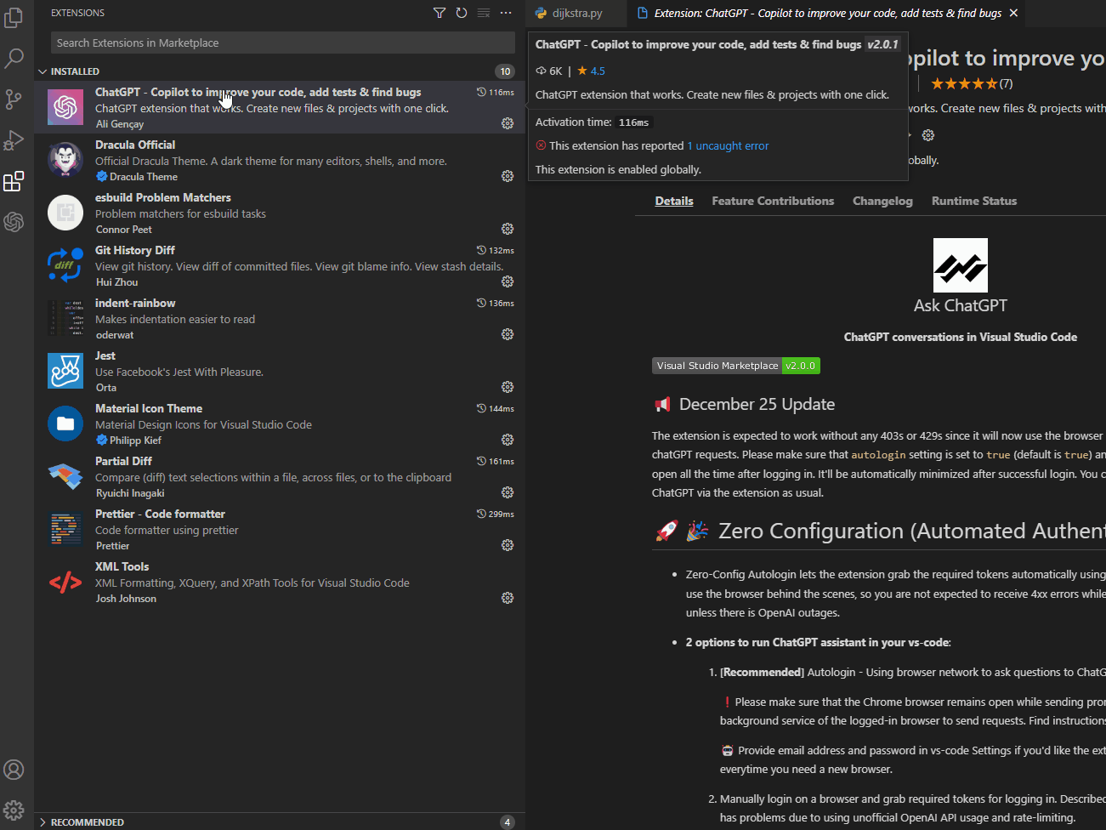

Slide 27
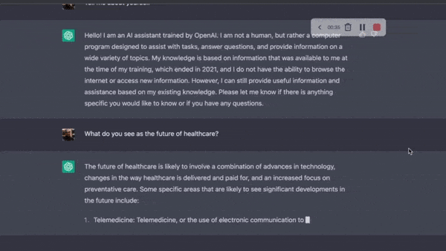

Slide 28
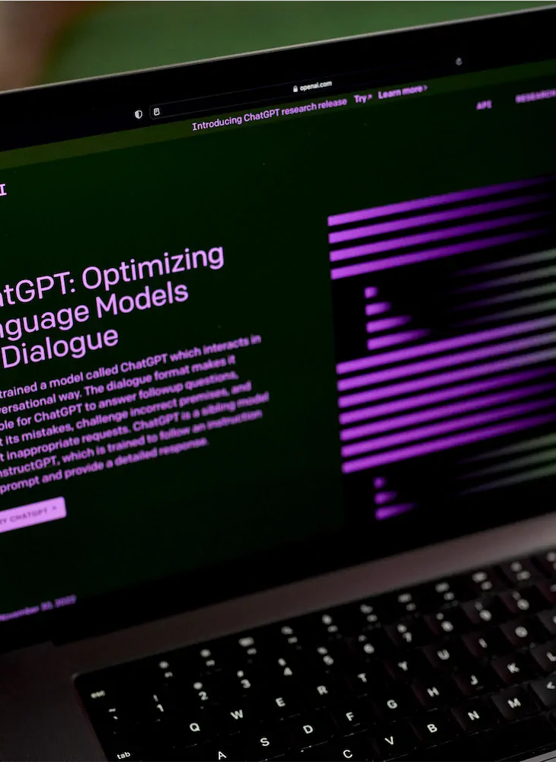
Future uses of ChatGPT
Customer Services
Personalized Recommendations
Language Translations
Content Creation
Virtual Assistants
Mental Health Support
Education

Slide 29
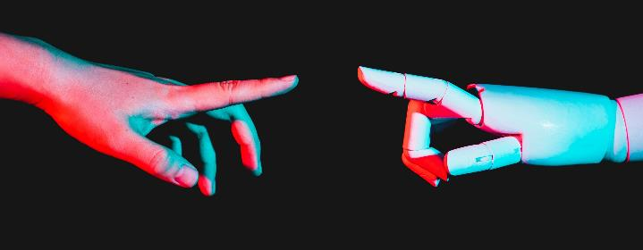
The evolution of Artificial Intelligence
Rule-based AI
Machine Learning
Neural Networks
Deep Learning
Reinforcement Learning
Natural Language Processing
Generative Models

Slide 30
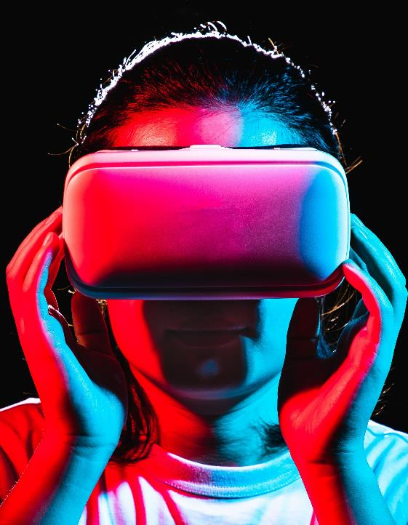
Comparıson of market
It is widely used in our country.
Microsoft provides the most important investment support.
ChatGPT
bard
It is not currently available in our country.
An AI robot created by Google.
​
lex
Amazon Lex is an AWS service for building conversational interfaces for applications using voice and text.​

Slide 31
Insights on the future of ChatGPT
Here are some insights on what we can expect
Improved performance
More natural language capabIlItIes
Increased personalIzatIon
As technology continues to advance, we can expect ChatGPT to become even more powerful and sophisticated, with increased accuracy and efficiency.
ChatGPT will continue to improve its natural language processing capabilities, allowing for more intuitive and human-like interactions.
ChatGPT will become even better at analyzing user data and generating personalized recommendations, further enhancing the user experience.

Slide 32
Insights on the future of ChatGPT
Here are some insights on what we can expect
IntegratIon wIth other technologIes
ExpansIon Into new domaIns
Ethical considerations
ChatGPT is likely to be integrated with other technologies, such as virtual and augmented reality, allowing for even more immersive and interactive experiences.
ChatGPT is already being used in a wide range of domains, from customer service to mental health support, and we can expect it to continue expanding into new areas, such as finance, law, and engineering.
As ChatGPT becomes more powerful and ubiquitous, there will be important ethical considerations to consider, such as privacy, bias, and transparency.

Slide 33
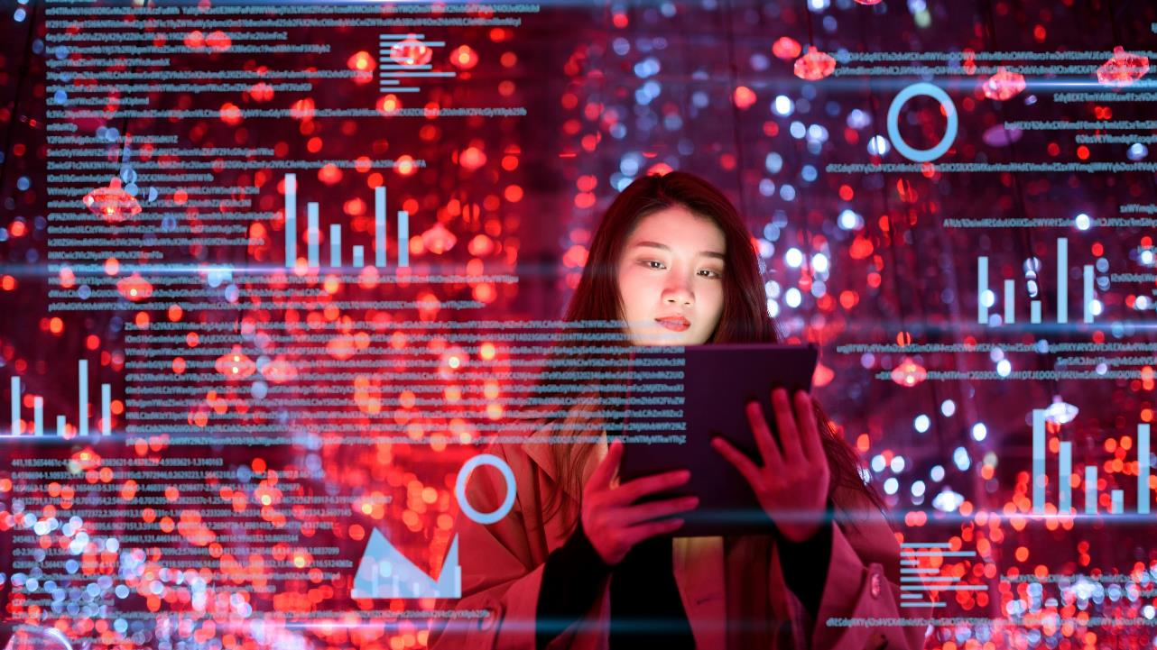
Importance of ChatGPT
Improved Communication
Increased Efficiency
Personalization
Accessibility
Mental Health Support
Education

Slide 34
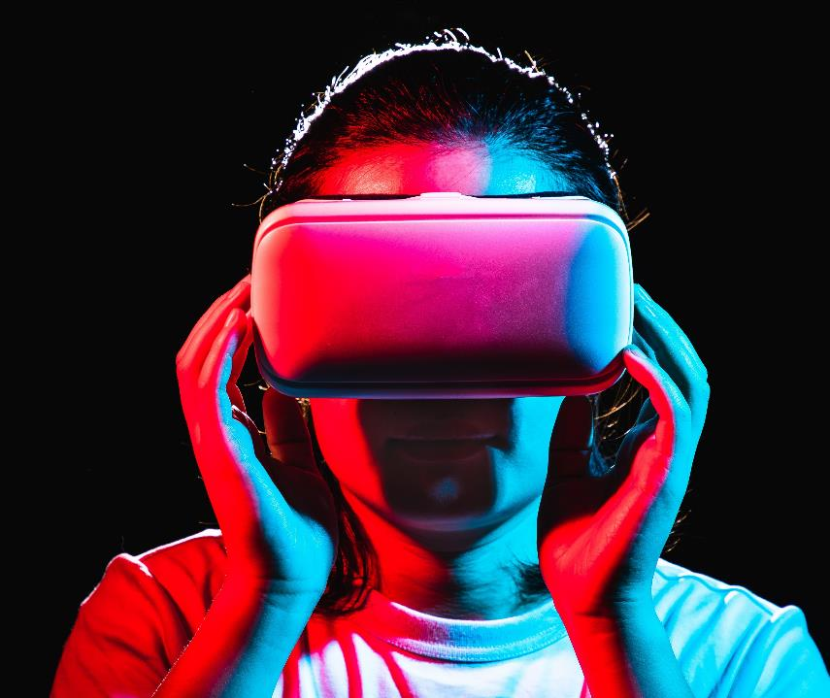

Teşekkürler
Beril Dindar​
berild@cloudcan.com​
https://cloudcan.com/

